Slide 1
Welcome
Peter Zaitsev,
Founder at Percona
10 June 2023

Slide 2
Enjoyed Peru with my Family

Slide 3
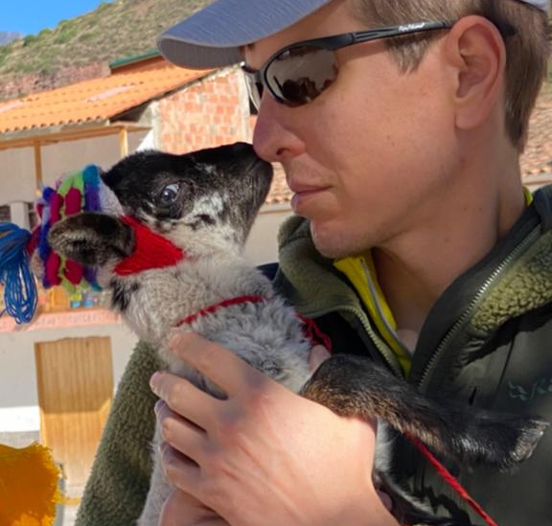
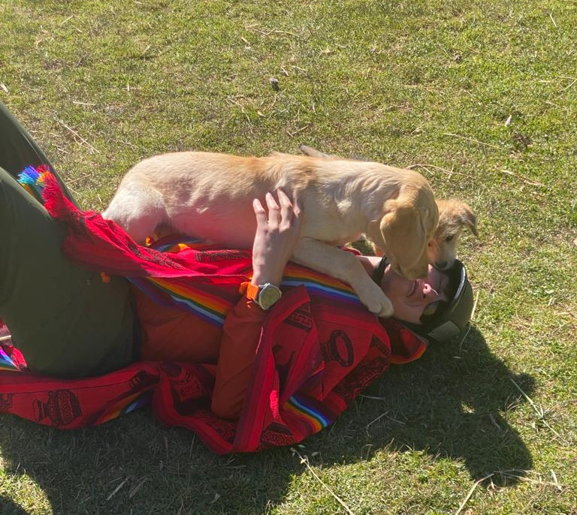
Close Encounters with Locals

Slide 4
Thank you
Notes:
Add logos of who we need to thank and put in the notes their names and for what we’re thanking them

Slide 5
Dawn Woolsey your friendly Percona Sales Person
dawn.woolsey@percona.com

Slide 6
We are Hiring!
Become a
Percona Superhero!
Contact
careers@percona.com
https://www.percona.com/about/careers

Slide 7
Cloud of Freedom
or
Cloud of Serfdom ?

Slide 8
My Prospective
Involved in Open Source since late 1990s
Early Staff member of MySQL AB
Founder, until recently CEO at Percona
Investor, Advisor, Mentor in Open Source Businesses
Open Source Advocate

Slide 9
Better
Everything being Equal Open Source is a better choice

Slide 10
Investment
It is smarter to invest in your resources in making Open Source better rather than paying for Proprietary Software

Slide 11
Open Source and Proprietary
https://momjian.us/main/writings/pgsql/forever.pdf

Slide 12
Operating Systems

Slide 13
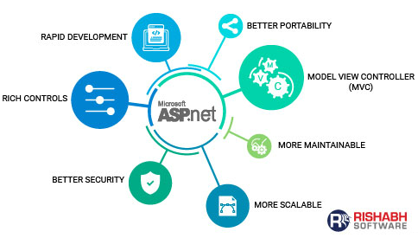
Have We Been Here Before?
2000s
2020s
2020s

Slide 14
Open Source in the Cloud
But do not Cloud Vendors just make Open Source Easier ?

Slide 15
Old Strategy
“Embrace, extend, and extinguish”

Slide 16
Usability and Ease of use
New Frontier for the competition

Slide 17
Reasons
Software Explosion
Data Explosion
Do More with Less (skills)

Slide 18
Cloud only Skills
Increasingly “Open Source Experts” have only Managed Cloud Solutions Skills

Slide 19
Cloud Vendor Push
Using their Proprietary or Managed solutions as Best Practice
1
Increasing Price Difference for such Managed Solutions
2
Embracing Scaling by Credit Card
3

Slide 20
Venture Funded Open Source
Often Abandon Open Source Licenses to Create Monopoly Protect themselves from Unfair Competition from the Cloud.

Slide 21
Community Open Source
Largely Embraces adoption by Cloud Vendors as it increases user base

Slide 22
Growth at any Cost
Focus on last decade was growth at any cost
Pushing as much on third parties (Cloud Vendors) makes sense
No resource to put on Open Source requiring “elbow grease”

Slide 23
Subsidized Cloud
First does of Heroin is Free

Slide 24
Things are Changing
https://a16z.com/2021/05/27/cost-of-cloud-paradox-market-cap-cloud-lifecycle-scale-growth-repatriation-optimization/

Slide 25
37Signals leaving the cloud
https://twitter.com/dhh/status/1613508201953038337

Slide 26
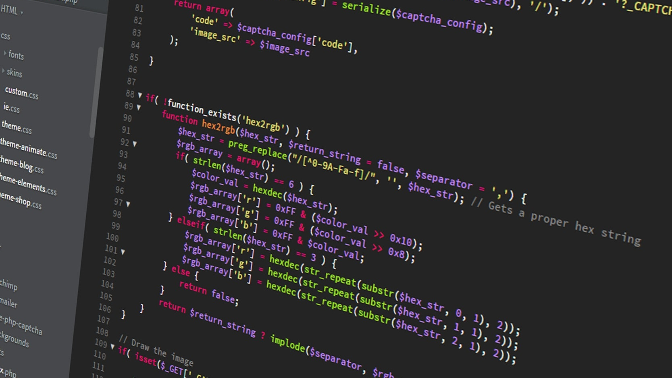
GitOps
Declarative Versioned Infrastractura as a Code

Slide 27
Hybrid Cloud
https://www.cncf.io/reports/cncf-annual-survey-2022/

Slide 28
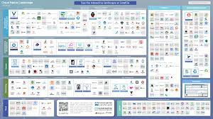
Open Source Catches Up Again
Lock-in with Cloud Vendor
Use Proprietary Solutions
Highly Differentiated Cloud
Hostage
No Vendor Choice
Freedom to Run Anywhere
Use Open Source
Cloud Is Commodity
Customer
Choice of Vendors

Slide 29
Cloud Native is Going Strong
https://landscape.cncf.io/

Slide 30
Giving Cloud Its Originally Intended Role of Commodity Infrastructure

Slide 31
Your Choice of Cloud
Cloud of Serfdom
Cloud of Freedom
Use a lot of Proprietary Features of your cloud vendor
Use Cloud Vendor as Commodity, Use Open Source

Slide 32
Smart API - Kubernetes

Slide 33
Getting Better

Slide 34
DOK Community
https://dok.community/

Slide 35
Adoption Areas
https://www.cncf.io/reports/cncf-annual-survey-2022/

Slide 36
Kubernetes Powers many DBaaS

Slide 37
Anywhere

Slide 38
Dashboard

Slide 39
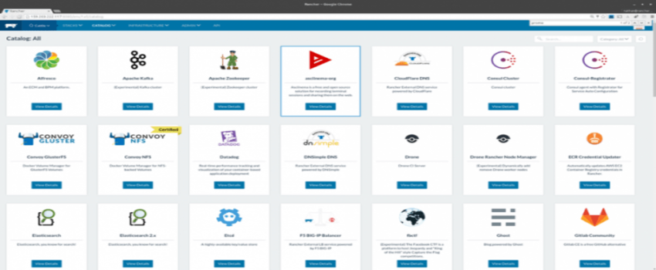
Applications

Slide 40
Next
Better Integrations
Better Usability
Day 2 Operations

Slide 41
Databases

Slide 42
Data Has Gravity
Hard to Move
Attracts/Pulls other Applications
Creates More Severe Vendor Lock-In
Should be your focus in Achieving your Freedom

Slide 43
Mission Critical Open Source Base Database Software

Slide 44
“Operators” to run them on Kubernetes

Slide 45
Observability and Simplified Management

Slide 46
Expertise you can count on
Support
Consulting
Managed Services

Slide 47
Unified As

Slide 48
Call For Action
Embrace Open Source in the Cloud
Invest in Making it Better
Spread the World
Run Percona 🫡

Slide 49
Thank you, Let’s Connect!
https://www.linkedin.com/in/peterzaitsev/
https://twitter.com/PeterZaitsev
http://www.peterzaitsev.com

