Slide 1
Exploring MySQL 8 Innovations
…and how Percona can help.

Slide 2
About your host
Arunji
group product manager at Percona
database engines: MySQL, PostgreSQL, MongoDB

Slide 4
Agenda
Where are we in the MySQL lifecycle journey?
Why are the instances still running on MySQL version 5.7?
Upgrade to MySQL 8.0: facts or urban legends!
MySQL 8 key changes!
MySQL 8.0 vs. 8.4!

Slide 5
Where are we in MySQL lifecycle?

Slide 6
MySQL 5.7 lifecycle
premier support end
initial release
initial release of MySQL 8.0
extended support end
Lifecycle of MySQL 5.7 was spanned across 8 years
Extended support ended on MySQL 5.7
Oct 2015
Apr 2018
Oct 31, 2020
Oct 31, 2023

Slide 7
MySQL 5.7 & 8.0 lifecycle
premier support end
extended support end
upgrade to MySQL 8.0 is already
initial release
possible
initial release of MySQL 8.0
The End of Life for MySQL 8.0 is in April of 2026
Oct 2015
Apr 2018
Oct 31, 2020
Oct 31, 2023
Mar 4 2025
we are here
MySQL 8.4 and 8.0 are actively supported for production use.

Slide 8
MySQL 5.7 extra support from Percona
3 years of extra support including error correction, beyond the Premier Support period, for specific MySQL releases; includes MySQL maintenance releases, updates, bug fixes
premier support end
(error correction), and security alerts.
initial release
initial release of MySQL 8.0
extended support end
The End of Life for MySQL 8.0 is in April of 2026
Oct. 9, 2015
Apr 8, 2018
Oct 31, 2020
Oct 31, 2023
Mar 2025
MySQL 8.4 and 8.0 are actively supported for production use.
we are here

Slide 9
MySQL 8.4: Long Term Support (LTS) Release
Release Date: April 2024
LTS Designation: MySQL 8.4.0 is designated as a Long Term Support (LTS) release.
Support Duration:
Premier Support: 5 years
Extended Support: 3 additional years
Total Extended Support End: Approximately April 2032.
The LTS release is the final minor version within its major release series.
8.4 is the 8.x LTS, then the next major release will be MySQL 9.0.

Slide 10
Why are the instances still running on MySQL version 5.7?

Slide 11
What prevents you from upgrading to MySQL 8.0?
answers from Percona customers
Technical reasons
version 8.0 unfit for use with the existing stack
unsolvable backend application dependencies
original development staff has left the company
might have tried upgrade to 8.0 in the past and failed
often customers with large, monolithic business applications

Slide 12
What prevents you from upgrading to MySQL 8.0?
answers from Percona customers
Technical reasons
Perception of cost and risk
have read about the horrors of the upgrade
are afraid of the unnamed risks and issues
understand that the cost of software and services’ maintenance is non-zero
version 8.0 unfit for use with the existing stack
unsolvable backend application dependencies
original development staff has left the company
might have tried upgrade to 8.0 in the past and failed
often customers with large, monolithic business applications

Slide 13
What prevents you from upgrading to MySQL 8.0?
answers from Percona customers
Technical reasons
Perception of cost and risk
have read about the horrors of the upgrade
version 8.0 unfit for use with the existing stack
unsolvable backend application dependencies
are afraid of the unnamed risks and issues
original development staff has left the company
understand that the cost of software and services’ maintenance is non-zero
might have tried upgrade to 8.0 in the past and failed
often customers with large, monolithic business applications
See no evil, hear no evil
“let’s not fix things which ain’t broken”
“let’s pretend this problem does not exist”

Slide 14
Upgrading from MySQL 5.7 to 8.0.
Facts or urban legends?

Slide 15
Upgrading MySQL from 5.7 to 8.0
Are there any real differences between MySQL 5.7 and 8.0?
Where are the missing 6.x and 7.x releases?

Slide 16
Upgrading MySQL from 5.7 to 8.0
Are there any real differences between MySQL 5.7 and 8.0?
Where are the missing 6.x and 7.x releases?
^{the answer to both} questions _{is}
“YES”

Slide 17
MySQL 8 key changes

Slide 18
Review of key changes
Major new capabilities and changes incorporated
General changes
InnoDB changes
Security and Account Management changes
Deprecations
Removals
Bonus upgrade impediment
This is what can truly impact the upgrade process.

Slide 19
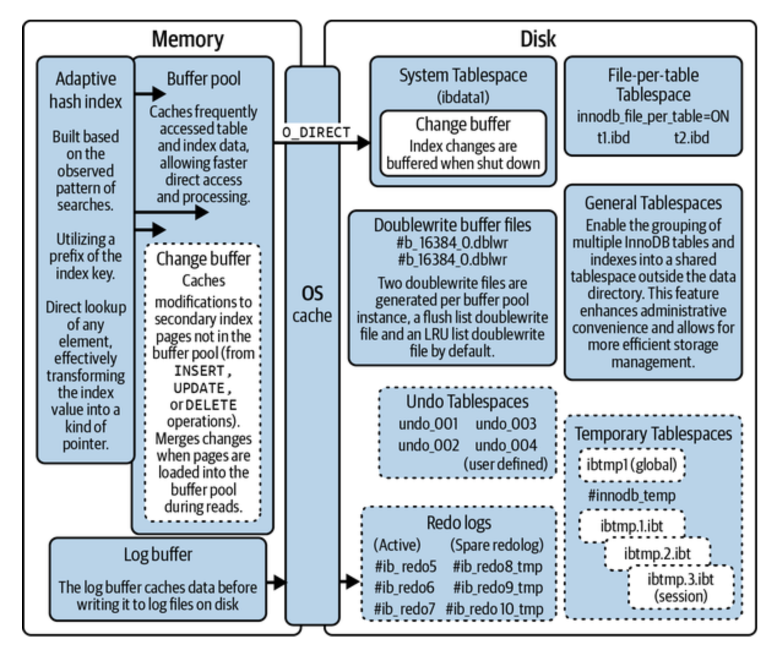

Slide 20
General changes in MySQL 8.0 vs. 5.7
new transaction data dictionary storing information about database objects
atomic DDL statement now combines data dictionary updates, storage engine operations and binary log writes associated with a DDL operation
MySQL server now automatically runs all necessary upgrade tasks (system tables, objects in other schemas like sys schema and user schema) at the next startup, so no need to manually run “mySQL_upgrade” as of version 8.0.16
SSL session reuse supported by default with the timeout setting
MySQL server now supports for creation and management of resource groups and permits assigning threads to particular groups
table encryption can be managed globally by defining and enforcing encryption defaults
default character set is changed from “latin1” to “utf8mb4”, which now has several new collations available
added support for expressions as default values for the BLOB, TEXT, GEOMETRY and JSON data types
new type of backup lock added, which permits DMLs during an online backup, while preventing operations which could result in an inconsistent snapshot
TCP/IP port can be now configured specifically for administrative connections, even if “max_connections” level is already reached on the primary port
added support for invisible indexes, which are not used by the optimiser and make it possible to test the effect of removing an index without actually removing it
added support for document store, for developing both SQL and NoSQL applications with a single DB engine
it’s now possible to persist global, dynamic server variables using the SET PERSIST command instead of SET GLOBAL

Slide 21
InnoDB changes in MySQL 8.0 vs. 5.7
the maximum auto-increment counter value is now persistent across the server restarts
in an event of index tree corruption, InnoDB writes a corruption flag to the redo log, which makes the corruption flag crash-safe
new dynamic variable “innodb_deadlock_detect” may be used to disable deadlock detection
InnoDB temporary tables are now created in session temporary tablespaces (*.ibt files)
system tables and data dictionary tables are now created in a single InnoDB tablespace names mysql.ibd, in the MySQL data directory
by default undo-logs now reside in two undo tablespaces that are created when the MySQL instance is initialised; undo logs are no longer created in the system tablespace
new “innodb_dedicated_server” variable (disabled by default) can be used to automatically configure the options based on the detected memory availability
tablespace files can be moved or restored to a new location while the server is offline using the “innodb_directories” option

Slide 22
Security and account management changes in MySQL 8.0 vs. 5.7
the grant tables in mysql system database are now InnoDB (transactional) tables
a new “caching_sha2_password” authentication plugin is available; like the “sha256_password” plugin, it implements SHA-256 password hashing, but uses caching to address latency issues
MySQL now supports FIPS mode, if compiled using OpenSSL with OpenSSL library and FIPS Object Module available at runtime. (Federal Information Processing Standards)
added support for roles which are names collections of privileges; roles can be created and dropped, and have privileges granted or revoked; roles can be granted to or revoked from users
administrators are now enabled to configure user accounts such that too many failed consecutive login attempts lead to temporary account locking
as of MySQL 8.0.27 the multi-factor authentication is supported which makes it possible to have up to three authentication methods enabled per account
user account categories concept incorporated, with system and regular users distinguished by SYSTEM_USER privilege
password history is now maintained, enabling restrictions on password reuse
somewhat outdated list of differences on MySQL website: https://dev.mysql.com/blog-archive/the-complete-list-of-new-features-in-mysql-8-0/

Slide 23
MySQL 8.0 vs. 8.4!
MySQL native password has long been depreciated, but it is no longer loaded by default.
The Innodb_flush_method has changed from fsync to ODIRECT on Linux. O_DIRECT if supported, otherwise fsync.
Using the terms MASTER and SLAVE in replication commands may finally be replaced by SOURCE and REPLICA.
innodb_change_buffering default set to none.
innodb_adaptive_hash_index default set to OFF.
And 143 bugs were fixed.
List of differences on MySQL website https://docs.oracle.com/cd/E17952_01/mysql-8.4-en/mysql-nutshell.html

Slide 24
New capabilities and changes. Already worried?
^{we are only} getting
started

Slide 25
Deprecations
the “AUTO_INCREMENT” support is deprecated for columns of type FLOAT and DOUBLE (and any synonyms); consider removing AUTO_INCREMENT attribute from such columns, or convert them to an integer type
the “utf8mb3” character set is deprecated, with “utf8mb4” recommended instead; “utf8mb3” is still valid in MySQL 8.0
the “sha256_password” plugin is deprecated and “caching_sha2_passoword” is recommended to use instead, as its superset
the “mysql_upgrade” client is deprecated because of its capabilities for upgrading the system tables in the mysql system schema, and objects in other schemas have been moved to MySQL server; as of MySQL
8.0.16 the server performs all these tasks
the “validate_password” plugin has been reimplemented to use the server component infrastructure; it is still available but deprecated
the “ENGINE” clause for all the ALTER TABLESPACE and DROP TABLESPACE statements is deprecated
the “PAD_CHAR_TO_FULL_LENGTH” SQL mode is deprecated
the “UNSIGNED” attribute is deprecated for columns of type FLOAT, DOUBLE and DECIMAL (and any synonyms); consider using a simple CHECK constraint instead
FLOAT(M,D) and DOUBLE(M,D) syntax to specify the number of digits for columns of type FLOAT and DOUBLE (and any synonyms) is a nonstandard MySQL extension and is is deprecated
The nonstandard C-style “&&”, “||”, and “!” operators that are synonyms for the standard SQL AND, OR, and NOT operators, respectively, are deprecated
The “mysql_upgrade_info file”, which creates a text file in the data directory and used to store the MySQL version number is deprecated
The “relay_log_info_file” system variable and “–master-info-file” option are deprecated; the use of files for the relay log info log and master info log has been superseded by crash-safe slave tables, which are the default in MySQL 8.0.
The use of the “MYSQL_PWD” environment variable to specify a MySQL password is deprecated.

Slide 26
Deprecations. You must act ASAP!
Deprecations are changes in the MySQL which will lead to Removals in future releases
While the features still exist, their usage will spill errors into log files and console output
^{the time to adjust} you
applications _{is NOW!, even}
^{if you are on 8.0} already

Slide 27
Removals
the “old_passwords” system variable
the “innodb_locks_unsafe_for_binlog” system variable was removed; instead use “READ COMMITTED” isolation level which provides similar functionality
using “GRANT” to create users; instead, use “CREATE USER”; following this practice makes the “NO_AUTO_CREATE_USER SQL” mode immaterial for GRANT statements, so it too is removed, and an error now is written to the server log when the presence of this value for the sql_mode option in the options file prevents mysqld from starting
using GRANT to modify account properties other than privilege assignments, including authentication, SSL, and resource-limit properties; instead, establish such properties at account-creation time with “CREATE USER” or modify them afterward with “ALTER USER”
“IDENTIFIED BY PASSWORD ‘auth_string’” syntax for “CREATE USER” and GRANT; instead, use “IDENTIFIED WITH auth_plugin AS ‘auth_string’” for “CREATE USER” and “ALTER USER”, where the ‘auth_string’ value is in a format compatible with the named plugin
the PASSWORD() function; additionally, PASSWORD() removal means that “SET PASSWORD … = PASSWORD(‘auth_string’)” syntax is no longer available
the query cache was removed; removal includes the following:
the FLUSH QUERY CACHE and RESET QUERY CACHE statements
these system variables: query_cache_limit, query_cache_min_res_unit, query_cache_size, query_cache_type, query_cache_wlock_invalidate.
these status variables: Qcache_free_blocks, Qcache_free_memory, Qcache_hits, Qcache_inserts, Qcache_lowmem_prunes, Qcache_not_cached, Qcache_queries_in_cache, Qcache_total_blocks.
These thread states: checking privileges on cached query, checking query cache for a query, invalidating query cache entries, sending cached result to the client, storing result in the query cache, Waiting for query cache lock.
the “tx_isolation” and “tx_read_only” system variables have been removed; instead use “transaction_isolation” and “transaction_read_only”
the “sync_frm” system variable has been removed because *.frm files have become obsolete.
the secure_auth system variable and “–secure-auth” client option have been removed; also the “MYSQL_SECURE_AUTH” option for the mysql_options() C API function was removed
the “log_warnings” system variable and “–log-warnings” server option have been removed; instead use the “log_error_verbosity” system variable
the global scope for the “sql_log_bin” system variable was removed; “sql_log_bin” has session scope only, and applications that rely on accessing “@@GLOBAL.sql_log_bin” should be adjusted

Slide 28
Removals - continued (1)
the unused “date_format”, “datetime_format”, “time_format”, and “max_tmp_tables” system variables are removed
the deprecated “ASC” or “DESC” qualifiers for “GROUP BY” clauses are removed; queries that previously relied on “GROUP BY” sorting may produce results that differ from previous MySQL versions; to produce a given sort order, provide an “ORDER BY” clause
the parser no longer treats N as a synonym for NULL in SQL statements; use NULL instead; this change does not affect text file import or export operations performed with “LOAD DATA” or “SELECT … INTO OUTFILE”, for which NULL continues to be represented by N
the client-side “–ssl” and “–ssl-verify-server-cert” options have been removed;
use “–ssl-mode=REQUIRED” instead of “–ssl=1” or “– enable-ssl”;
use “–ssl-mode=DISABLED” instead of “–ssl=0”, “– skip-ssl”, or “–disable-ssl”
use “–ssl-mode=VERIFY_IDENTITY” instead of “–ssl- verify-server-cert” options
The “mysql_install_db” program has been removed from MySQL distributions;
data directory initialisation should be performed by invoking “mysqld” with the “–initialize” or “–initialize-insecure” option instead;
in addition, the “–bootstrap” option for “mysqld” that was used by “mysql_install_db” was removed, and the “INSTALL_SCRIPTDIR” CMake option that controlled the installation location for “mysql_install_db” was removed
The “mysql_plugin” utility was removed
alternatives include loading plugins at server startup using the “–plugin-load” or “–plugin-load-add” option, or at runtime using the “INSTALL PLUGIN” statement
The “resolveip utility is removed”
instead use “nslookup”, “host”, or “dig”

Slide 29
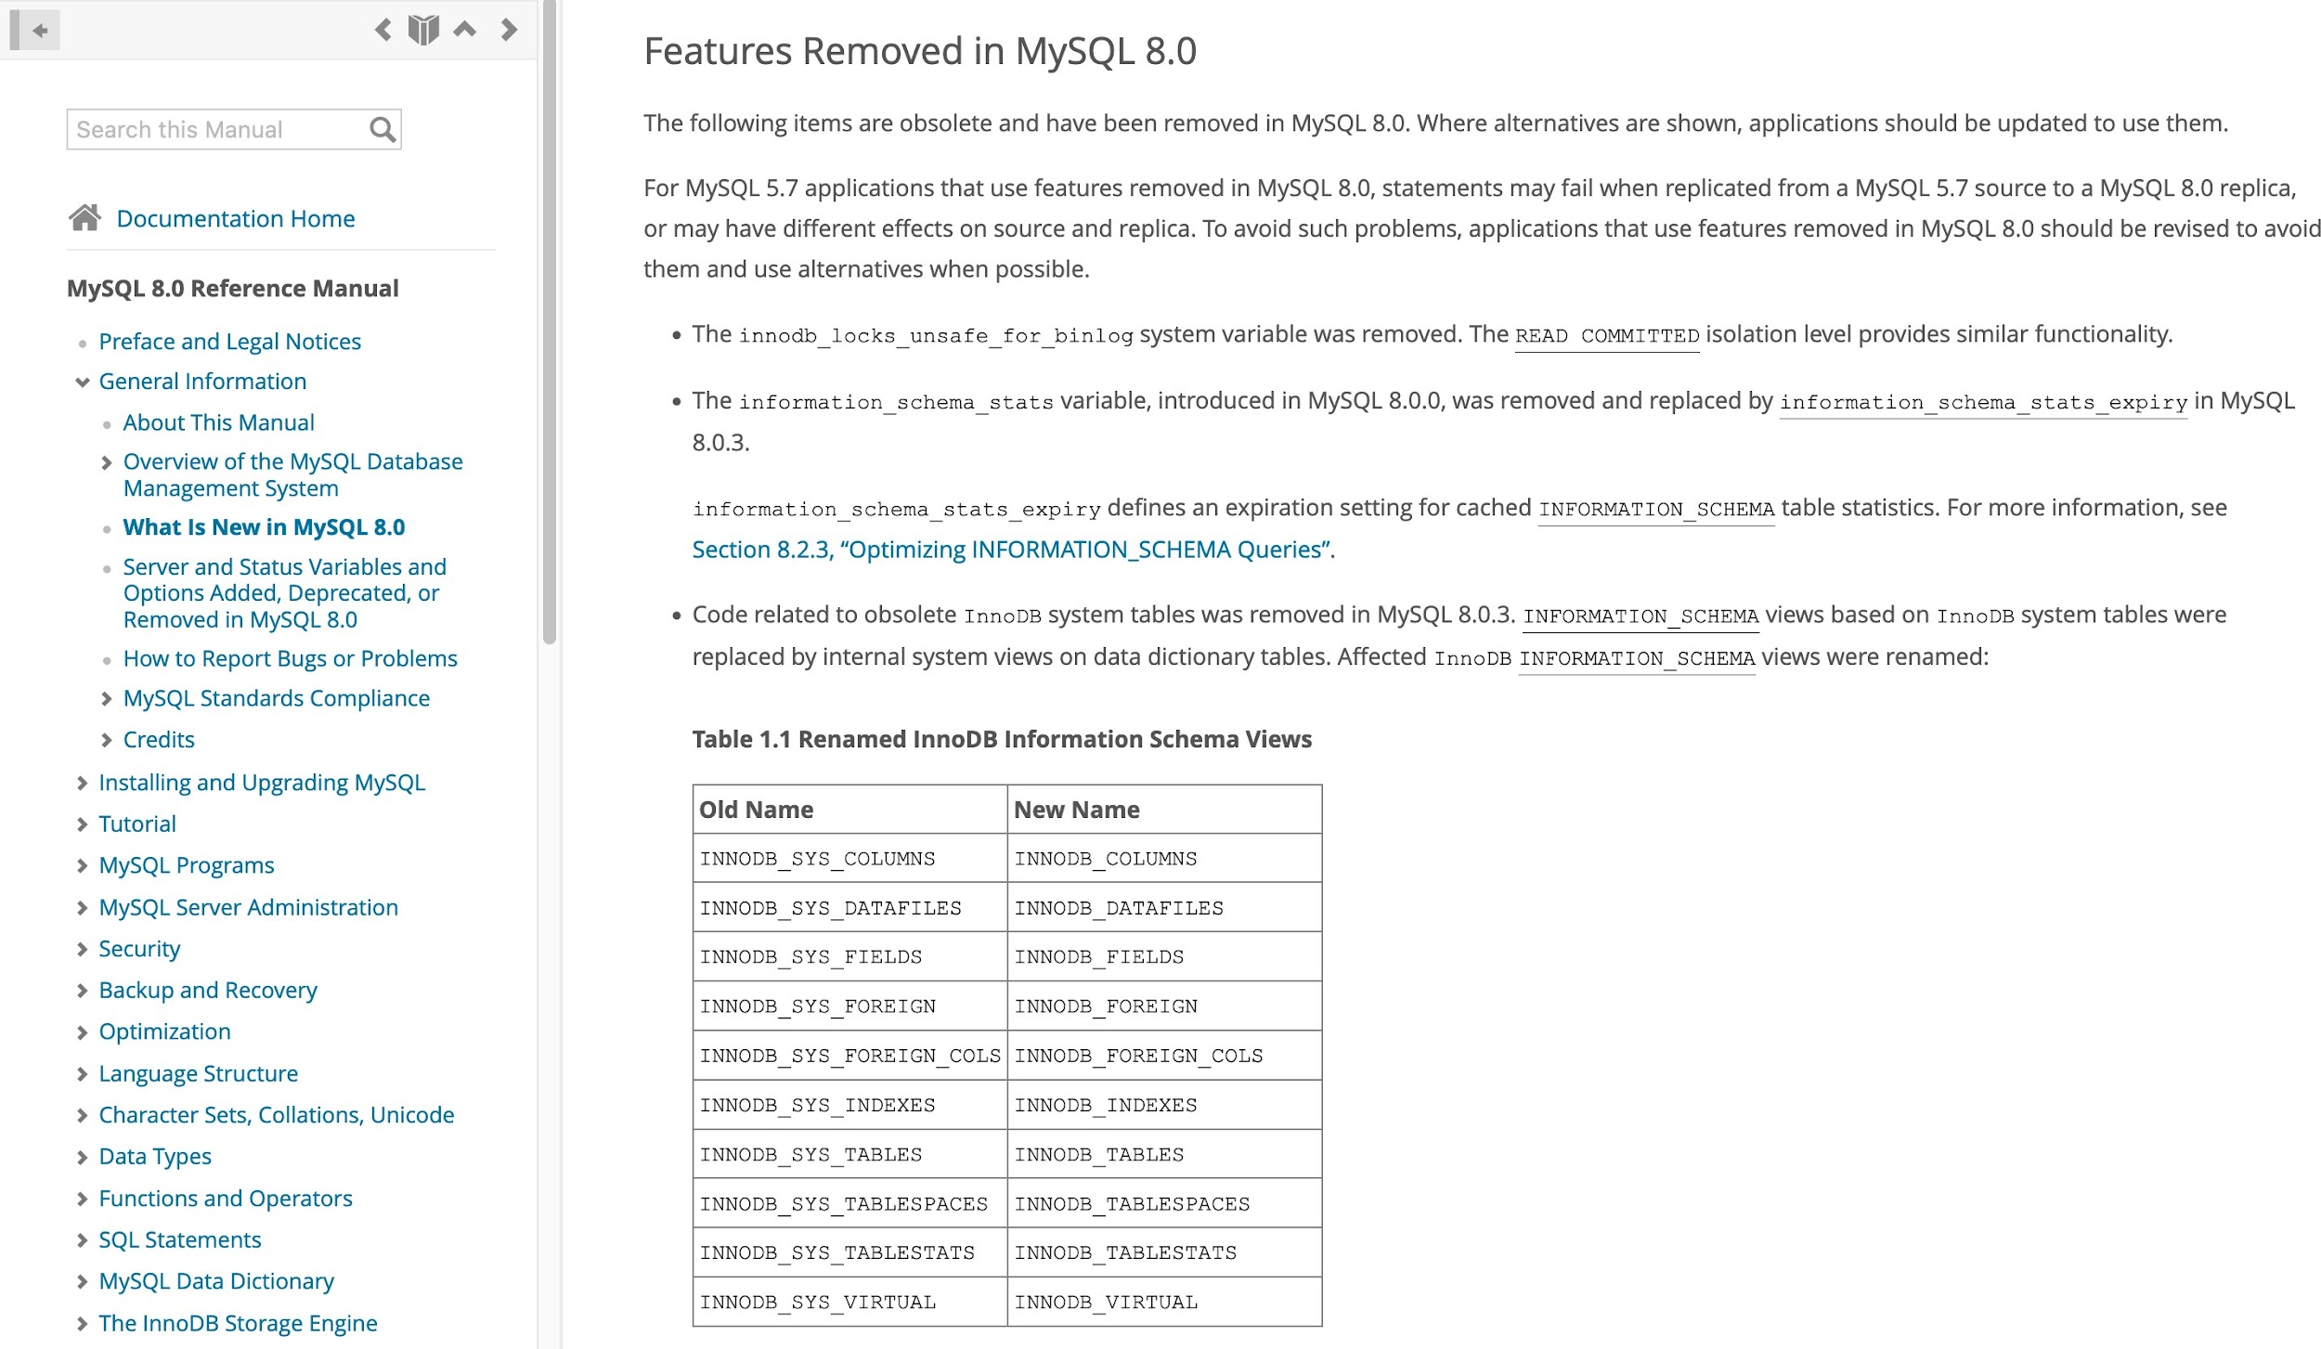
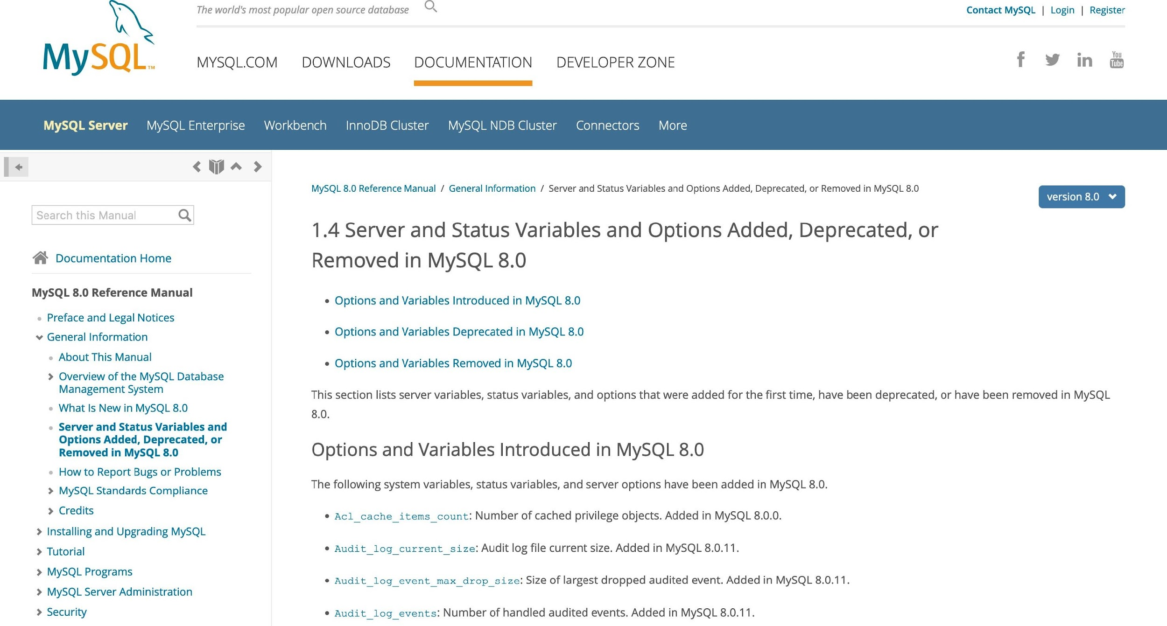
Removals - continued (2)
more information about removed server and status variables
more information about removed features
https://dev.mysql.com/doc/refman/8.0/en/mysql-nutshell.html#mysql-nutshell-removals
https://dev.mysql.com/doc/refman/8.0/en/added-deprecated-removed.html

Slide 30
Removals. This is your homework before upgrade.
^{checking for} removals’ _{conflicts}
^{is the key} prerequisite _{for a}
successful _{upgrade}

Slide 31
Bonus upgrade impediment
Minor version upgrades in MySQL 8.0 are
unidirectional
There is no easy way of performing a quick minor version rollback

Slide 32
Q&A
^{the answer to some} questions _{is}
“YES”

Slide 33
Talk to me!
Arunjith Aravindan
https://www.linkedin.com/in/arunjith-a-0b9b4652/
https://www.facebook.com/arunjith.a

