Slide 2
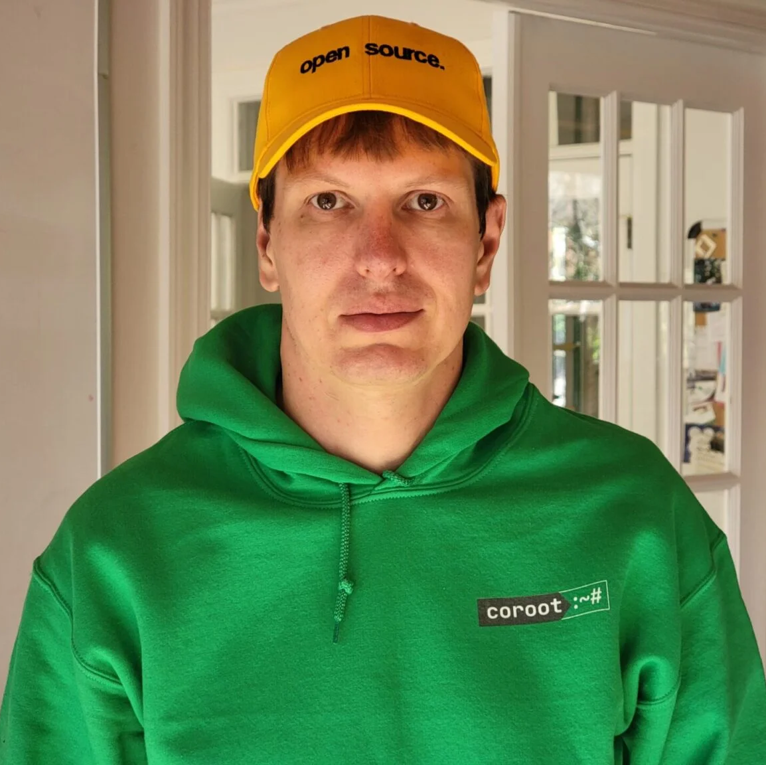
What Developers Should Know about Observability
Peter Zaitsev,
Co-Founder at Coroot
March 4, 2025

Slide 3
Let’s Get to Know You

Slide 4
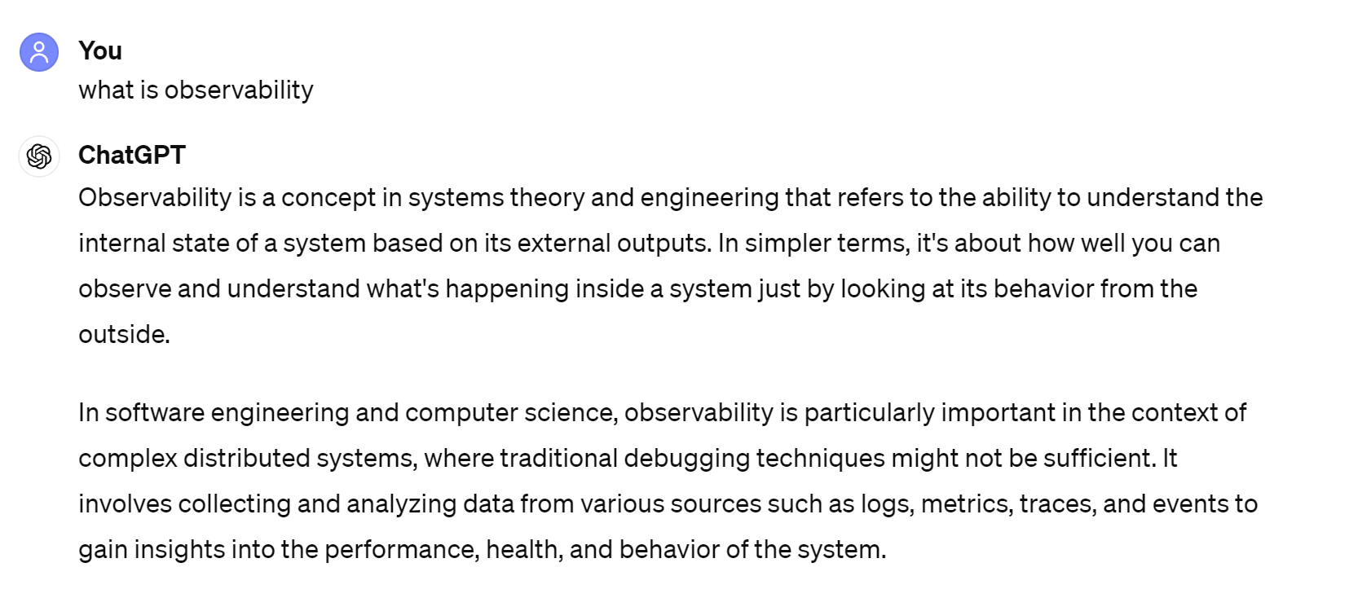
What is Observability?

Slide 5
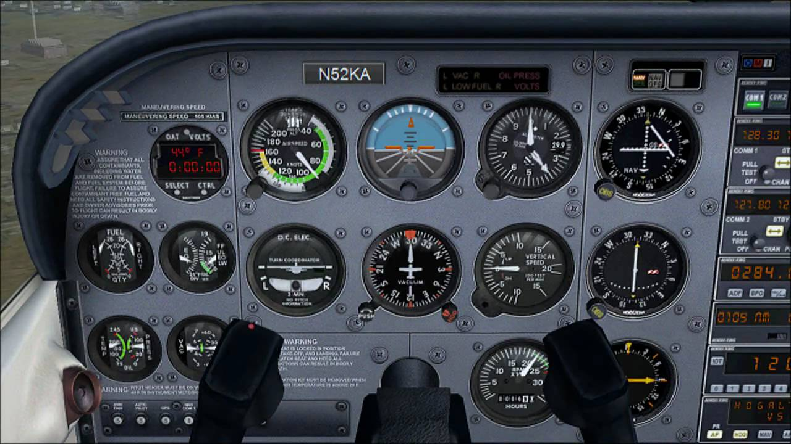
What Is Observability

Slide 6
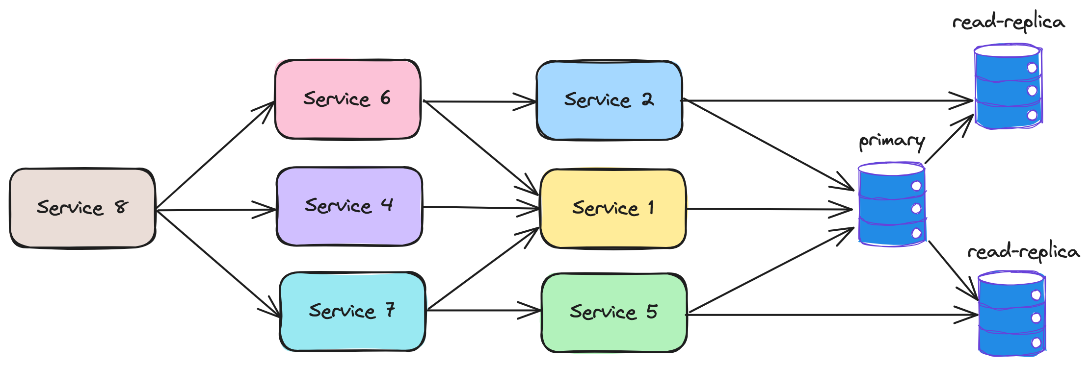
Evolution of the Applications
2000s
2020s

Slide 7
Why Observability?
Availability
Performance
Cost Management
Security

Slide 8
Tasks Observability Helps with
Reactive
Troubleshooting and Optimization
Proactive
Finding Problems before they are Big Problems

Slide 9
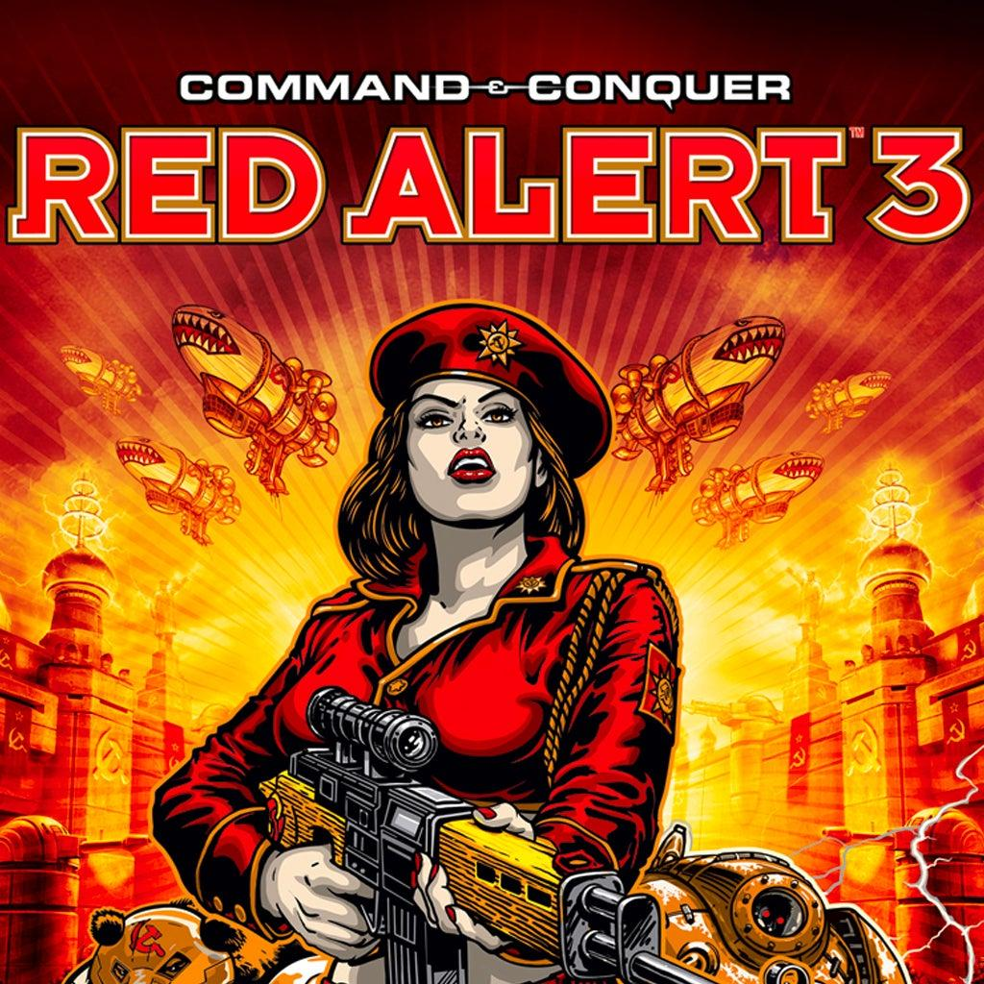
Alerting
Notifies when Problem happens
Ensures the Right Escalation happens and the problem is resolved

Slide 10
4 Pillars of Observability
Metrics
Logs
Tracing
Profiling

Slide 11
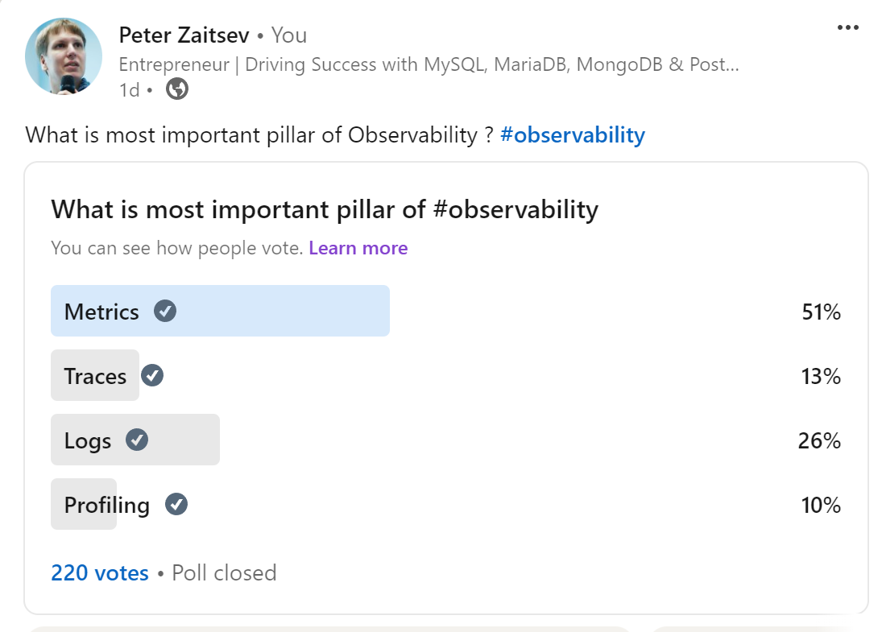
What is the Most Useful?

Slide 12
Metrics
High Level overview
How many requests/sec there are happening?
How many errors?
Is the Host Down?
1000s of metrics may be collected every second
Displayed on hundreds of graphs

Slide 13
Logs
Structured and Unstructured Format
Have detailed information on what is happening
Error logs – contain detailed information about cause of errors
Expensive to Produce
Expensive to Store and Analyze
Sampling and Filtering is often used

Slide 14
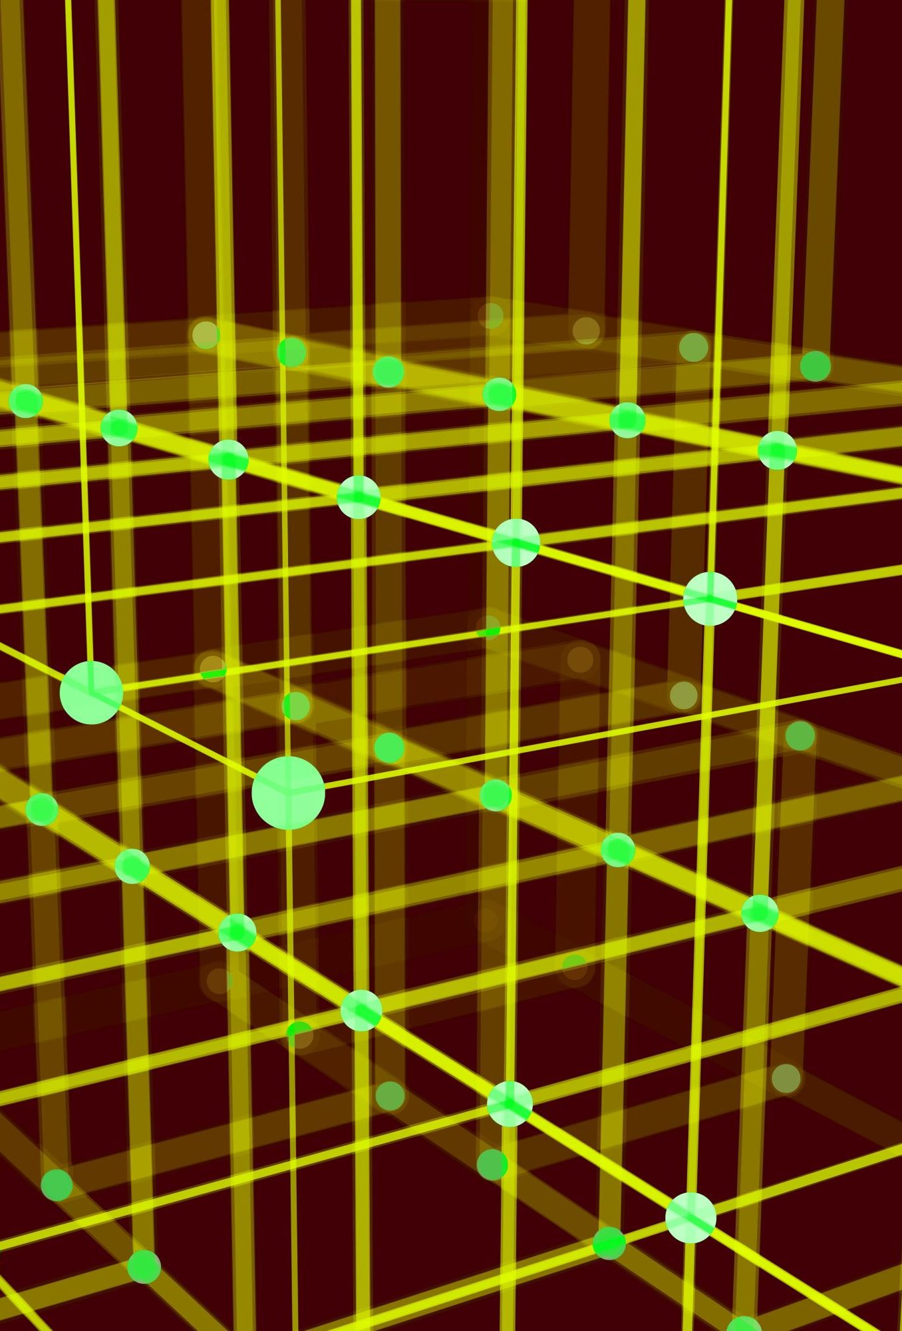
Distributed Tracing
Tracks Application Requests as they Pass through the system
Tricky as we need to pass some Trace_ID between different services
Span – Named, Timed Operation which represents part of Workflow
Great for Root Cause Analyses
Often Sampled
Expensive to produce and store

Slide 15
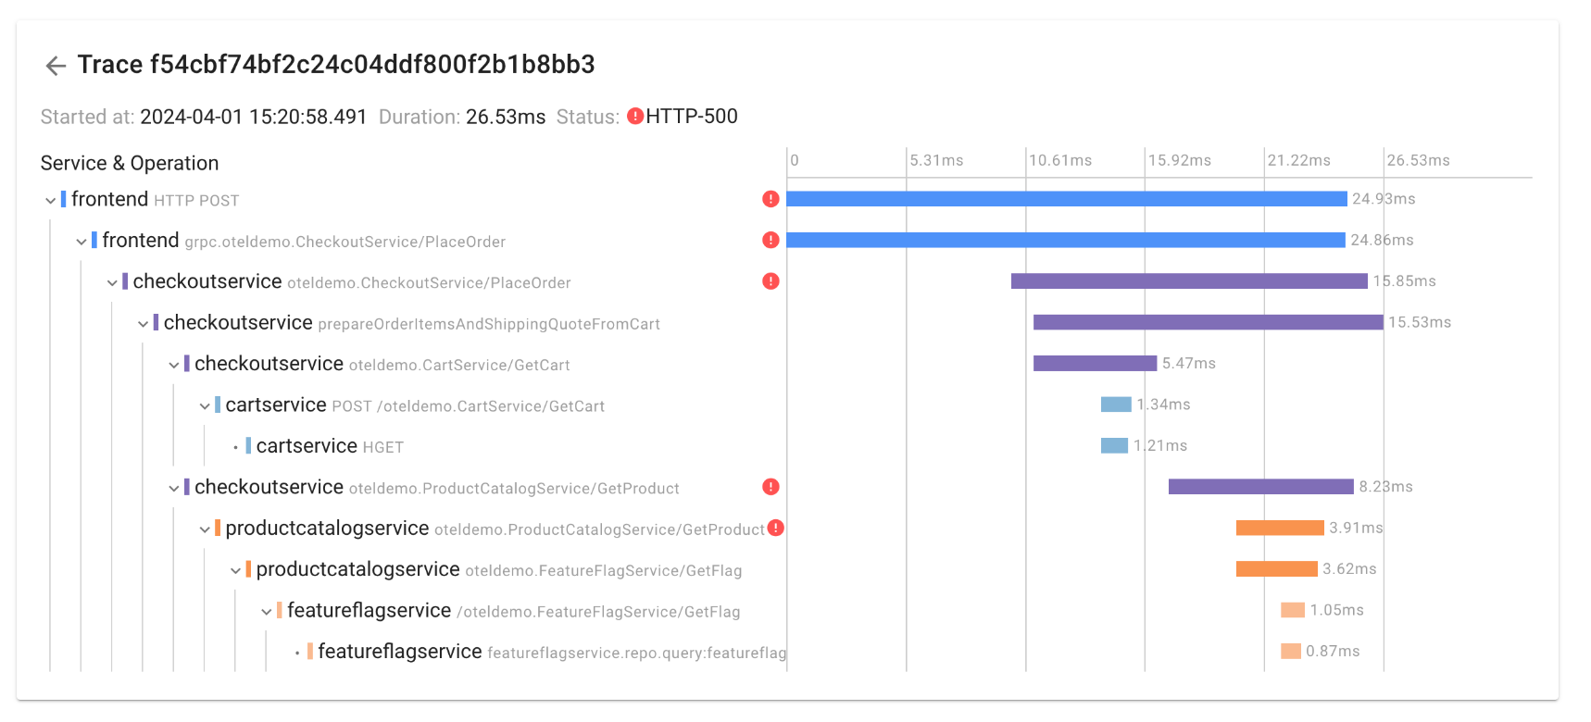
Distributed Tracing Example

Slide 16
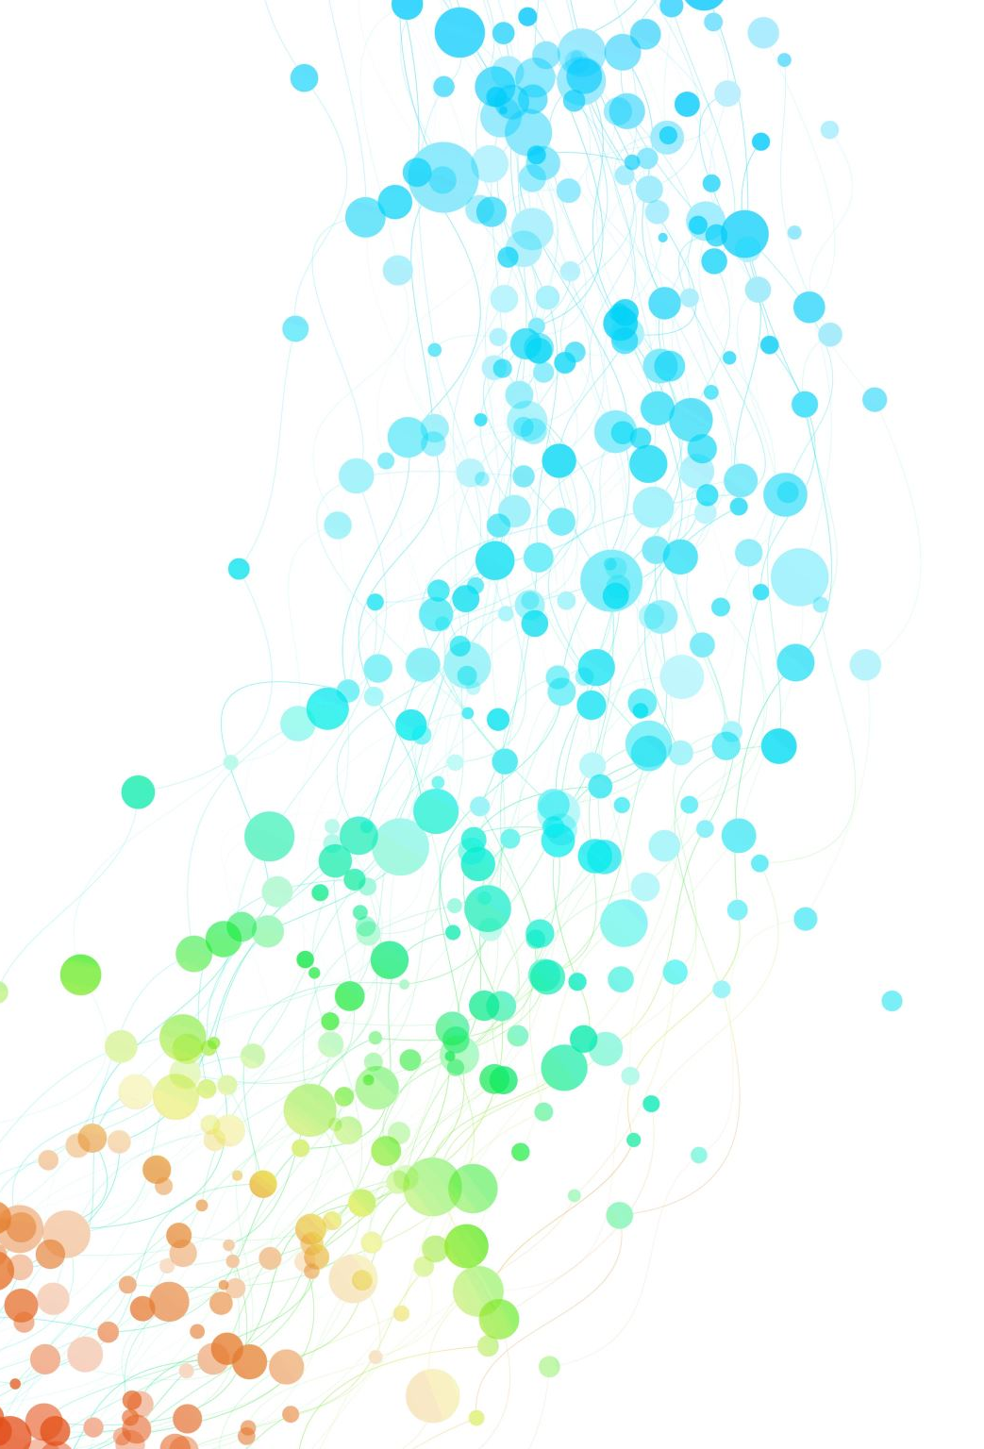
Profiling
Where CPU Time or Wall Clock time is Spent
Single Service or Distributed
Language Developer can Understand
Comparisons are very helpful
Programming language specific support needed

Slide 17
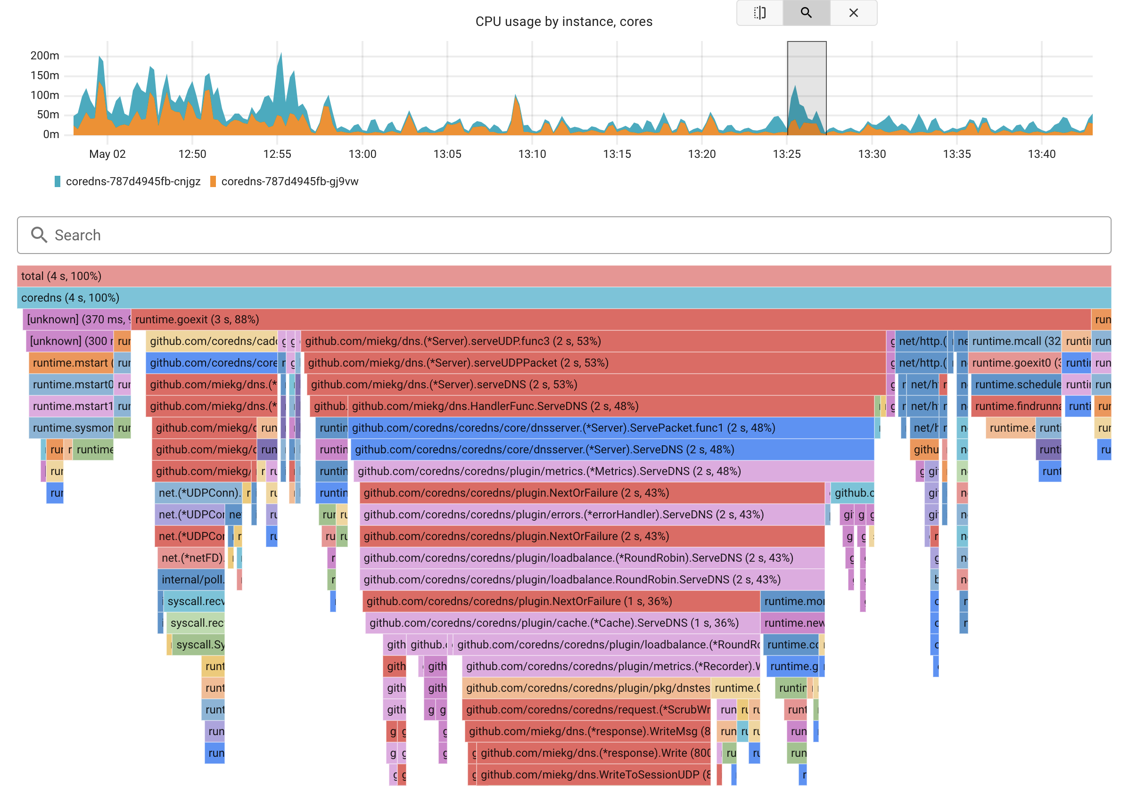
eBPF Based CPU Profiling in Coroot

Slide 18
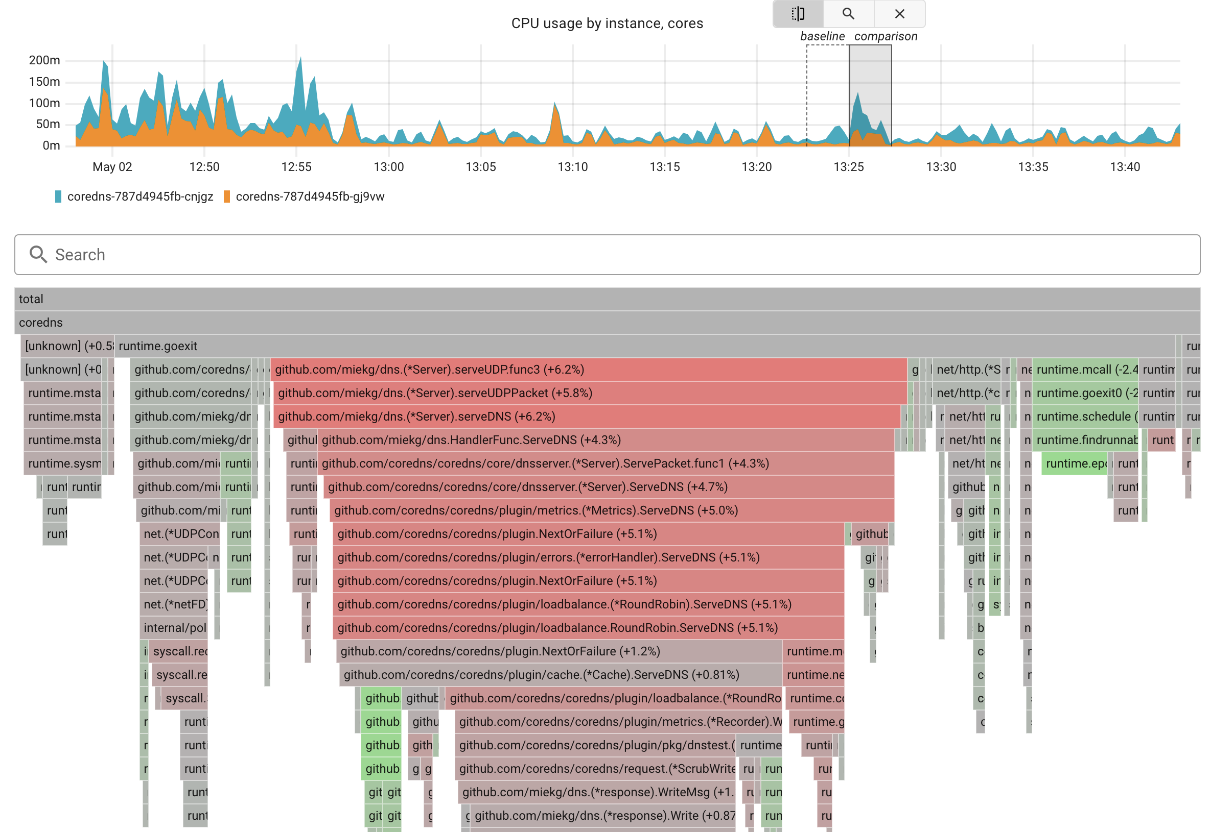
Profiling: Comparison Mode

Slide 19
Instrumentation
How do we get all that Observability?

Slide 20
Types of Instrumentation
Static Instrumentation
Specific Places in the Code can Produce Metrics, Emit Logs, Traces
Linux ProcFS
Dynamic Instrumentation
Allow Instrumentation “anything” dynamically
dTrace, eBPF

Slide 21
Key Observability Technologies

Slide 22
Prometheus
Metrics Capture and Processing
OpenMetrics merged here
Client Libraries for many programming languages
Easy way to expose Metrics from your Application
Coding Required

Slide 23
Open Telemetry (OTEL)
Collection of APIs, SDKs and Tools
To Instrument, Generate, Collect and Export Telemetry Data
Covers Metrics, Logs, Traces
Formed through merger of OpenTracing and OpenCensus projects
Coding Required

Slide 24
eBPF (Extended Berkley Packet Filter)
Not Just Observability
Dynamic Instrumentation
User Space and Kernel Space
Efficient
Safe
No Coding Required

Slide 25
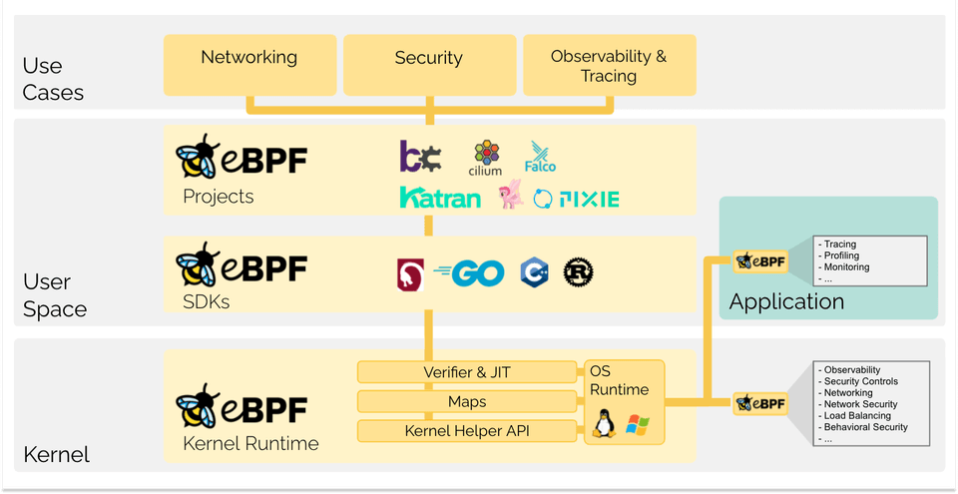
eBPF Illustrated
https://ebpf.io/what-is-ebpf/

Slide 26
Typical SLIs (Service Level Indicators)
Rate of Requests
Hard to define what is norm, through anomaly detection can help
Availability
Error Rate; High Latency Becomes Error at certain point
Request Latency
Looking at 99% or more; Often with breakdown

Slide 27
Observability Problems

Slide 28
Hard To Deploy
Too much effort and agent configuration required

Slide 29
Hard to cover all of Infrastructure
Many solutions support only some kinds of infrastructure well

Slide 30
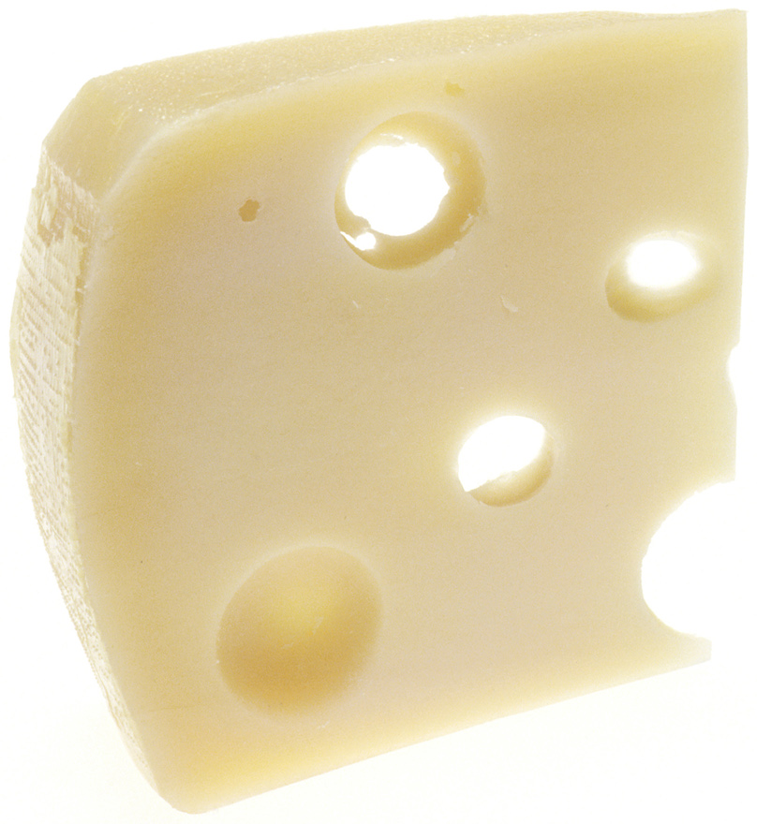
Swiss Cheese Observability
Full of Holes!

Slide 31
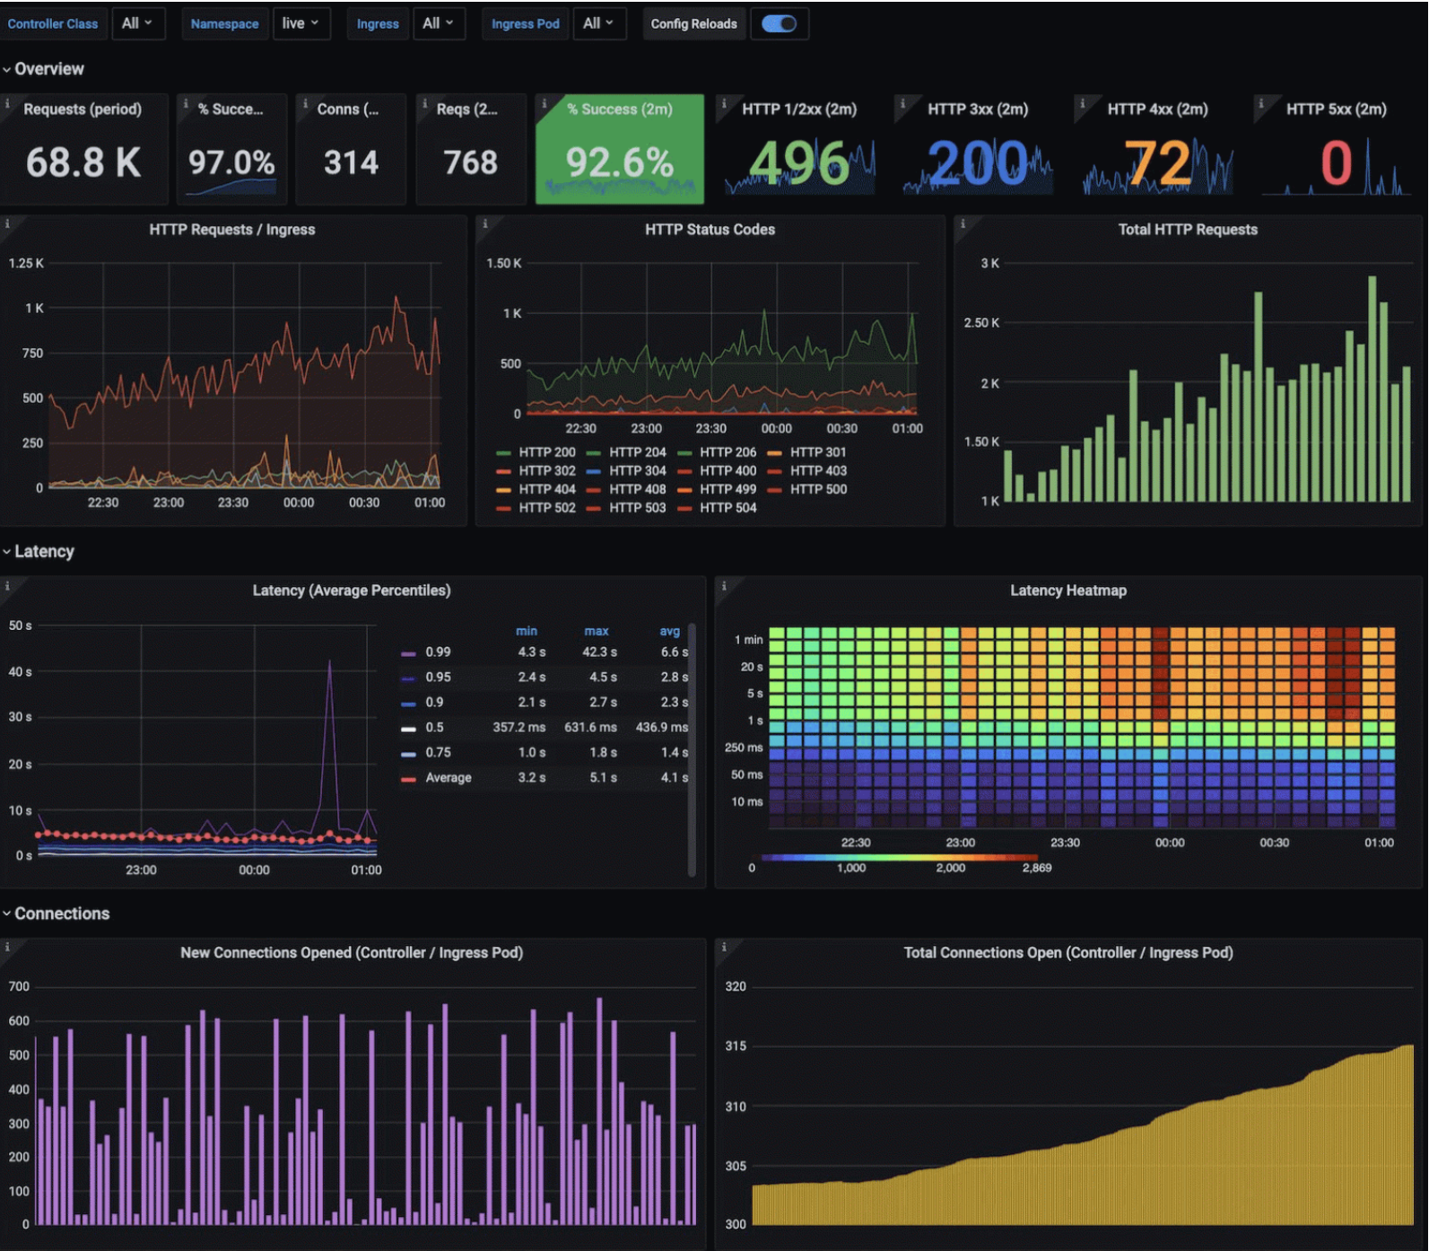
Hard to Use
Overwhelming amount of hard to understand data

Slide 32
Silos
Large organizations have many groups with different responsibilities
Multiple Vendors responsible for different parts of infrastructure
Often using different tools
Blame game and responsibility avoidance is common

Slide 33
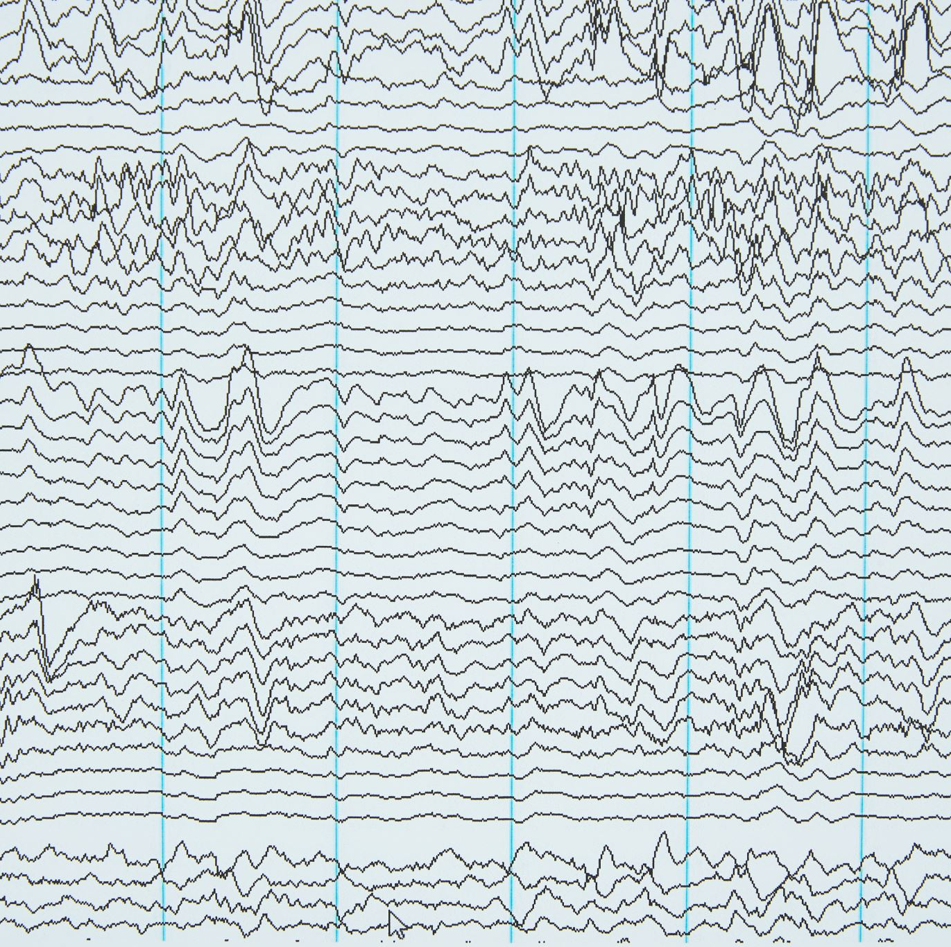
Noise
Too much Noise in Alerting
Team Fatigue and Burnout
Alerts being Ignored or Mishandled
Increased Downtime
Poor User Experience

Slide 34
Overhead
Instrumentation Slow things down
Observability data hard to store and process
Inadequate Level of Instrumentation

Slide 35
Cost
Proprietary and Cloud Observability solutions can get super expensive
Why do you think Cisco bought Splunk ?
High Costs drive Observability Choices
Need Open Source, Efficient Solutions

Slide 36
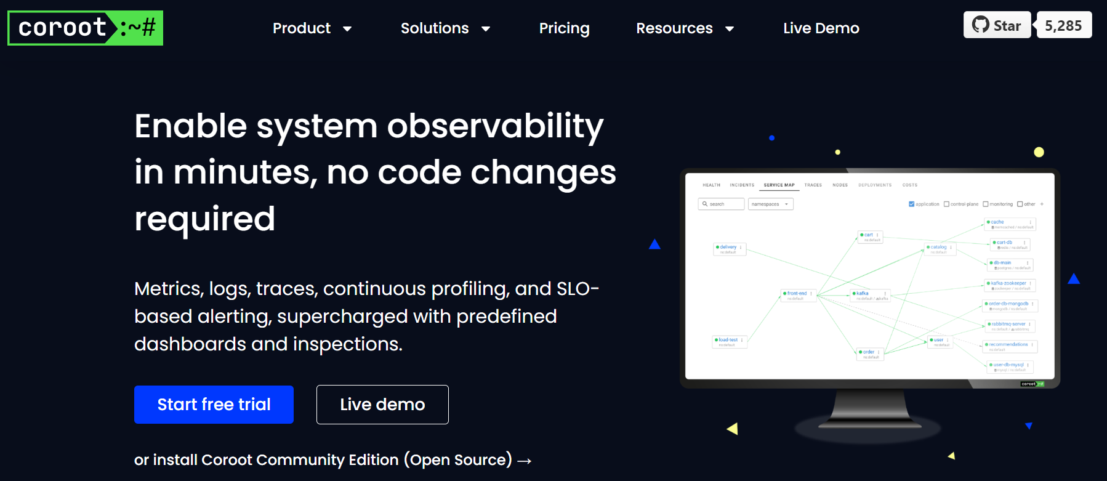
Coroot – Looking to Solve Some of Those

Slide 37
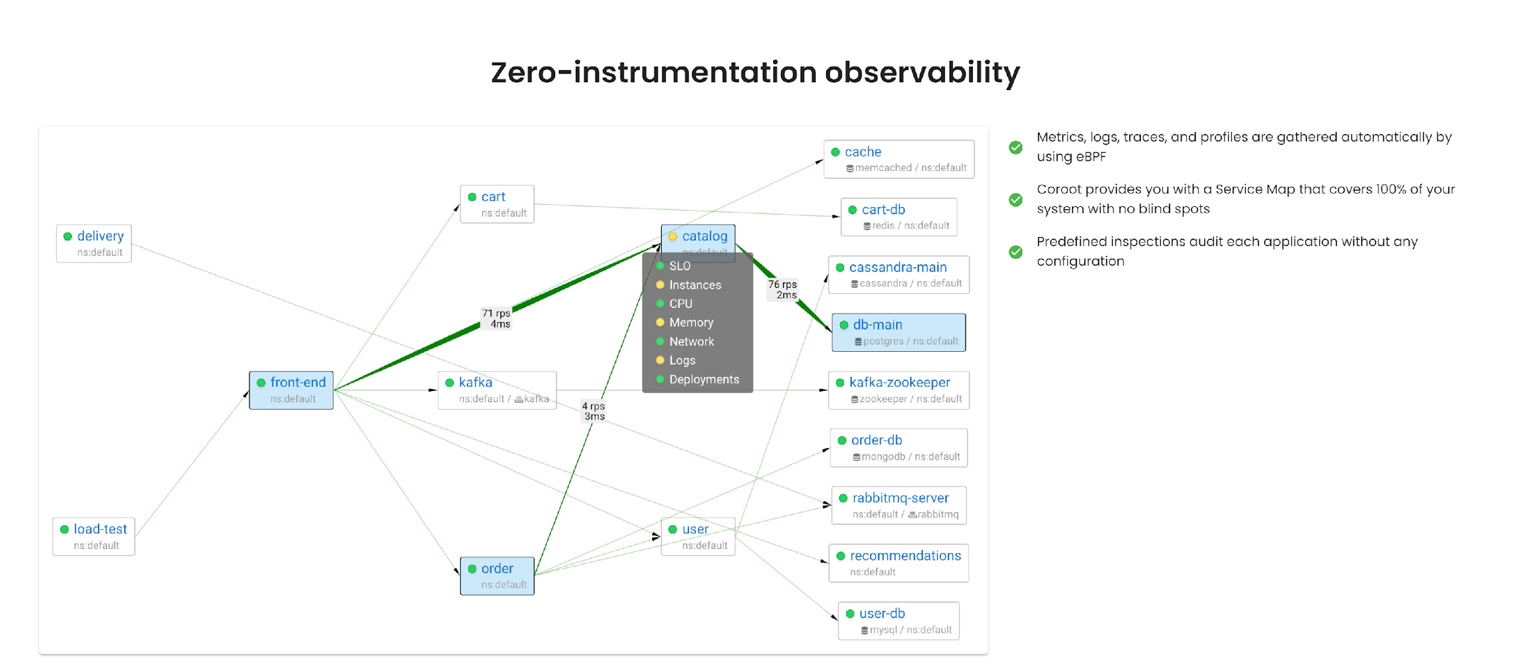
Coroot Editions
Open Source
Enterprise
https://coroot.com/

Slide 38
eBPF Magic
Automatic Instrumentation with eBPF
Use to together with conventionally exposed Linux Data
Instrument SSL Calls
L7 Protocol Decoding

Slide 39
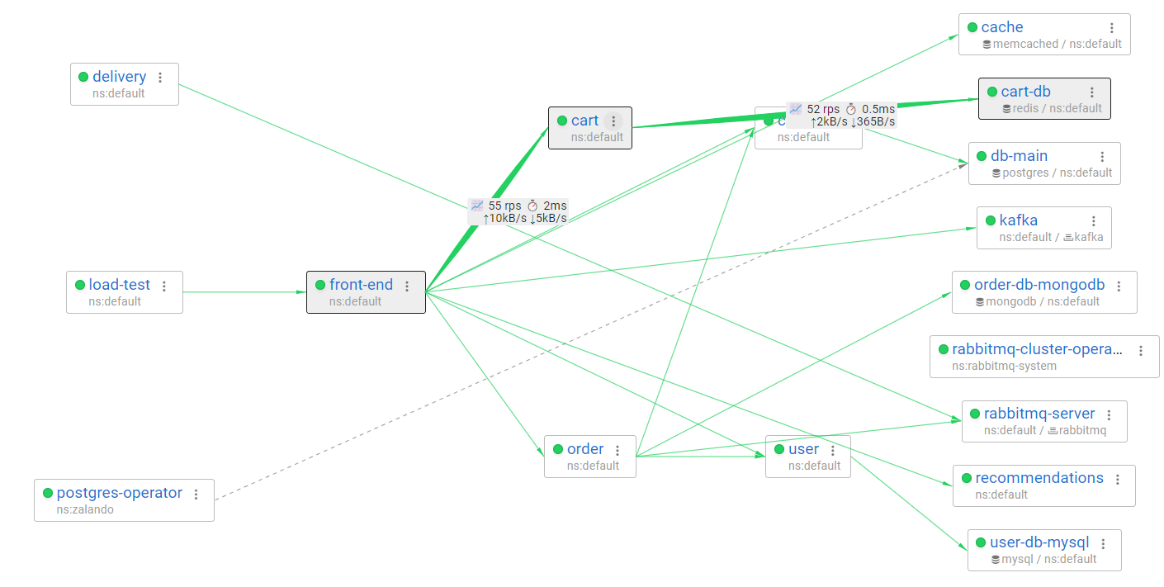
eBPF-based metrics

Slide 40
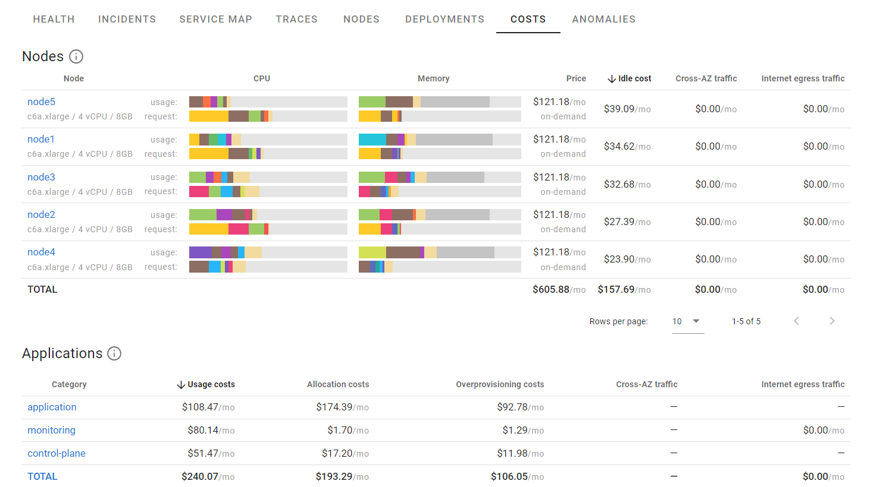
Node Types & Costs for major clouds

Slide 41
Handling Observability Problems

Slide 42
Hard to Deploy
No Code, No Configuration to get 90% of the Value

Slide 43
Hard to cover all the Infrastructure
Cover Kubernetes, Containers, Cloud, VM, Bare Metal

Slide 44
Hard to Use
Less Raw Data, More Actionable Insights

Slide 45
Silos
Complete Infrastructure and App Coverage
Evidence based Root Cause Analyses

Slide 46
Noise
Focus on Objective Measures rather than Vanity Ratios

Slide 47
Overhead
eBPF – Modern Technology designed for speed
Heavily Optimized Open Source Agents

Slide 48
Cost
Roll your own
Flexible data retention options
State of Art Data Storage Technologies

Slide 49
Words of Advice
Ensure your observability is complete, with no blind spots
Ensure you have tools to reliably identify the components experiencing issues
Use skill-appropriate tools, less can be more in the time crunch
Have evidence for escalation to another team or vendor

Slide 50
Thank you!
Let’s Connect!
https://www.linkedin.com/in/peterzaitsev/
https://twitter.com/PeterZaitsev
http://www.peterzaitsev.com

